Slide 1
Lecture 08: 8253/4 Timer

Slide 2
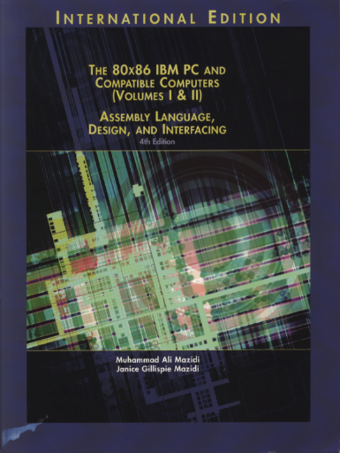
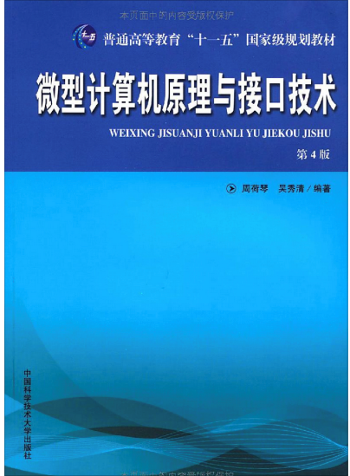
Reference Book:
The 80x86 IBM PC and Compatible Computers
Chapter 13 8253/4 Timer and Music
微型计算机原理与接口技术（第四版）
第8章 可编程计数器／定时器8253/8254及其应用

Slide 3
Package & Internal Structure
The 8253/54 Programmable interval timer is used to generate a lower frequency for various uses
e.g.,
Event counter
Accurate time delays
Software:
setting up a timing loop
Hardware:
using 8253 to count out the delay and interrupt the CPU
Pros and cons?
MOV CX, N
AGAIN: LOOP AGAIN

Slide 4
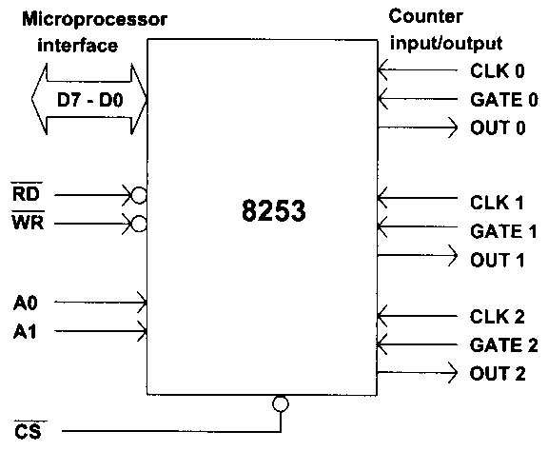
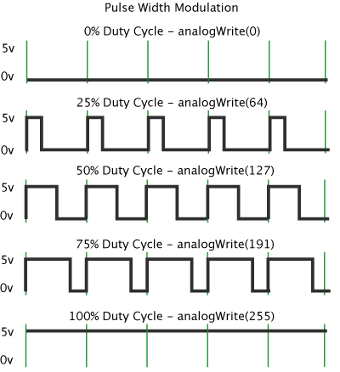
Interface to the System
There are three independent counters.
The input frequency can be divided from 1 to 65536 (Binary), or from 1 to 10000 (BCD)
Shape of the output frequency:
Square-wave
One-shot
Square-wave with various duty cycles.
Gate is used to enable (High) or disable (Low) the counter.
If bidirectional bus D0-D7 is connected to D0-D7 of the system bus, even addresses in 8086 system.

Slide 5
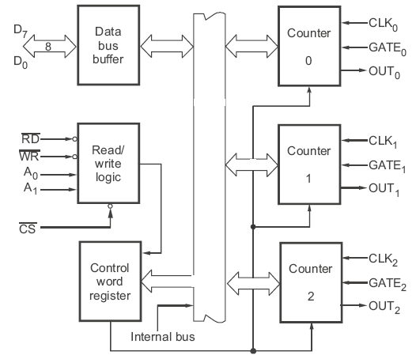
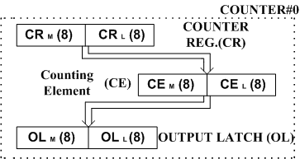
Internal Structure
To operate a 16-bit down counter
a 16-bit count is loaded in the counter
begins to decrement the count until it reaches 0
generates a pulse that can be used to interrupt the CPU

Slide 6
Features
Three independent 16-bit down counters
8254 can handle inputs from DC to 10 MHz (5MHz 8254-5 8MHz 8254 10MHz 8254-2) whereas 8253 can operate up to 2.6 MHz
Three counters are identical and pre-settable, and can be programmed for either binary or BCD count
Counter can be programmed in six different modes
Compatible with all Intel and most other microprocessors
8254 has powerful command called READ BACK command which allows the user to check the count value, programmed mode and current mode and current status of the counter

Slide 7
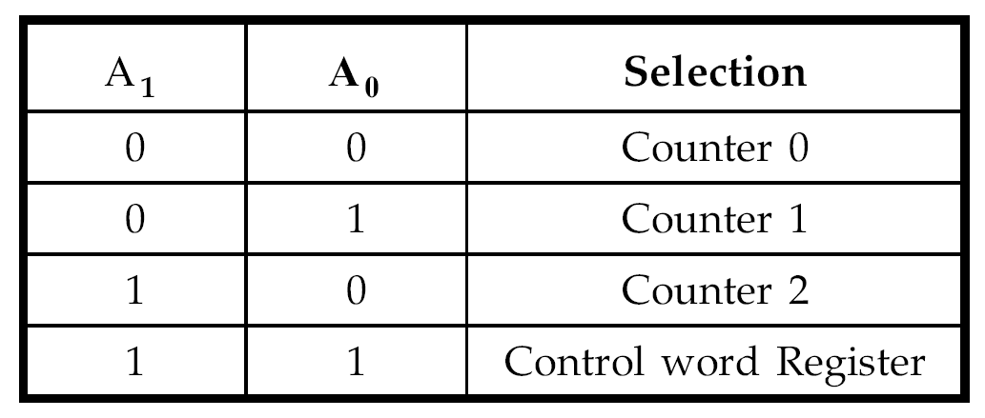
Internal Structure & Pins
Data bus buffer
interface the 8253/4 to the system data bus
Bi-directional, tri-state, 8-bit
Read/Write control logic
~CS
Tied to a decoded address
~RD, ~WR
In isolated I/O: ~IOR, ~IOW
Memory-mapped I/O: ~MEMR, ~MEMW
A₁, A₀
Select the control word register and counters
usually connected to address lines A₁, A₀
/CS | /RD | /WR | A1A0 | FUNCTION
0 0 0 0 | 1 1 1 1 | 0 0 0 0 | 00 01 10 11 | Write counter0 (to CR0) Write counter1 (to CR1) Write counter2 (to CR2) Write control port
0 0 0 0 | 0 0 0 0 | 1 1 1 1 | 00 01 10 11 | Read counter0 (from OL0) Read counter1 (from OL1) Read counter2 (from OL2) Read control port (for 8254)
1 | X | X | XX | Not available

Slide 8
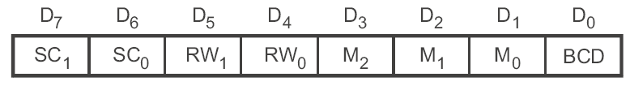

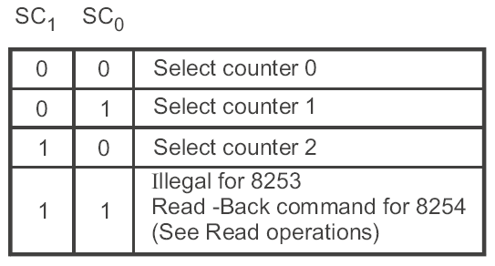

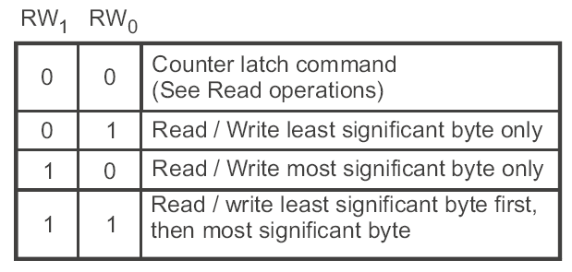

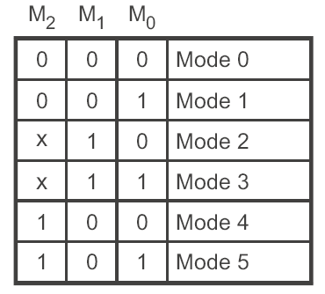
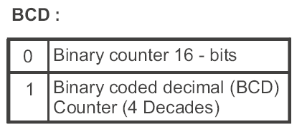
Internal Structure & Pins
Control Word Register:
Selected when A₁=1, A₀=1
Used to specify which counter to be used, its mode, and a read or write operation
Counters:
Each consists of a single, 16-bit, pre-settable, down counter
Can operate in either binary or BCD
Input, gate and output are configured by the selection of modes
Reading from a counter does not disturb the actual count in process

Slide 9
Write/Read Operations
WRITE:
Write a control word into control register
Load the low-order byte of a count in the counter register
Load the high-order byte of a count in the counter register
READ:
Simple Read: two I/O read operations, first one for low-order byte and last one for the high order byte
Counter Latch Command: one I/O write operation used to write a control word to the control register to latch a count in the output latch, then two I/O read operations are used to read the latched count as in Simple Read.
Read-Back Command: for 8254 only

Slide 10
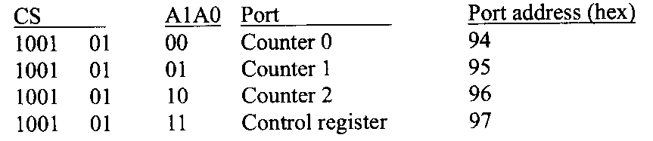

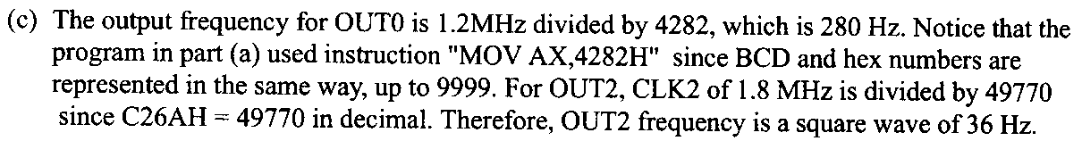
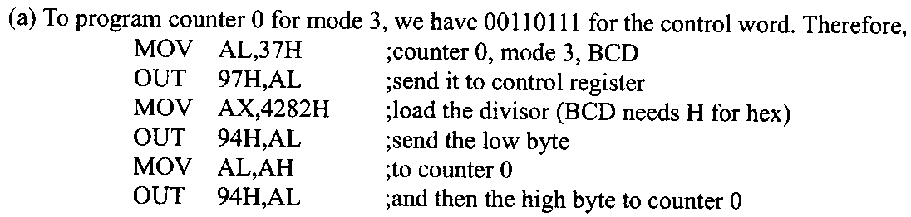
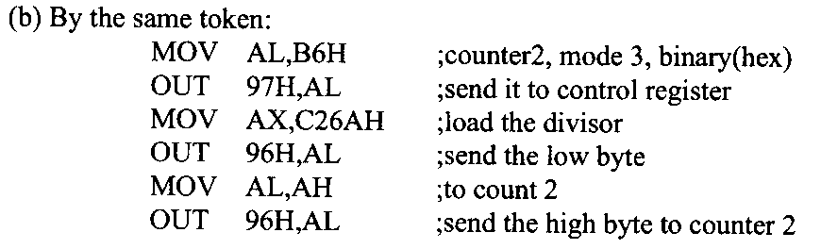
Example: Setting Up a Counter

Slide 11
Features of 8253
8253 takes one CLK pulse to convey the count from CR to CE
CE will start to count only when GATE = 1
When to check the GATE?
On every CLK pulse’s rising (0-to-1) edge
When to count down?
On every CLK pulse’s falling (1-to-0) edge

Slide 12
Mode 0 : Interrupt on Terminal Count (1)
Normal Operation:
The output will be initially low after the mode set operation;
After the count is loaded into the selected CR the output will remain low
When the terminal count is reached, the output will go high and remain high until the selected counter is reloaded
Output: N clock pulses low and high afterwards after writing a count

Slide 13
Mode 0 : Interrupt on Terminal Count (2)
Gate disable:
Gate = 1 enables counting
Gate = 0 disables counting
New count:
If a new count is written to the counter, it will be loaded on the next CLK pulse and counting will continue from the new count
In case of two byte count:
Writing the first byte disables the current counting
Writing the second byte loads the new count on the next CLK pulse and counting will continue from the new count

Slide 14
Mode 0: Interrupt on Terminal Count (3)
When loading a new count N, the actual number of CLK pulses in OUT is N+1
Does not automatically repeat

Slide 15
Mode 1: Hardware Retriggerable One-shot (1)
Normal Operation:
The output will be initially high after the mode set operation;
The output will go low on the CLK pulse following the rising (0-to-1) edge of the gate input;
The output will go high on the terminal count and remain high until the next rising edge of the gate input.
Output: one-shot of N clock pulses on every trigger

Slide 16
Mode 1 : Hardware Retriggerable One-shot (2)
Retriggering:
retriggerable, hence the output will remain low for the full count after any rising edge of the gate input
New count:
If the counter is loaded during one shot pulse, the current one shot is not affected unless the counter is retriggered
If retriggered, the counter is loaded with the new count and the one-shot pulse continues until the new count expires

Slide 17
Mode 1 : Hardware Retriggerable One-shot (3)
When loading a new count N, the current counting will not be affected
Does not automatically repeat

Slide 18
Mode 2: Rate Generator (1)
Normal Operation:
The output will be initially high;
The output will go low for one clock pulse before the terminal count;
The output then goes high, the counter reloads the initial count and the process is repeated
Output: periodical signal with a period of N-1 clock pulses high and 1 clock pulse low

Slide 19
Mode 2: Rate Generator (2)
Gate disable:
If Gate=1 it enables a counting otherwise it disables counting (Gate=0)
If Gate goes low during an low output pulse, output is set immediately high
New count:
The current counting sequence is not affected when the new count is written
If a trigger (a rising edge of GATE) is received after writing a new count but before the end of the current period, the new count will be loaded with the new count on the next CLK pulse and counting will continue from the new count
Otherwise, the new count will be loaded at the end of the current counting cycle
Note : In mode 2, a count of 1 is illegal. Why?

Slide 20
Mode 2: Rate Generator (3)
When loading a new count N, the current counting will not be affected
Automatically repeat on terminal count

Slide 21
Mode 3: Square Wave Rate Generator (1)
Normal Operation:
The output will be initially high;
For even count, counter is decremented by 2 on the falling edge of each clock pulse; when reaches terminal count, the state of the output is changed and the counter is reloaded with the full count and the whole process is repeated
For odd count, the first clock pulse decrements the count by 1. Subsequent clock pulses decrement the clock by 2. After timeout, the output goes low and the full count is reloaded. The first clock pulse (following the reload) decrements the count by 3 and subsequent clock pulse decrement the count by two. Then the whole process is repeated.
Output: if the count is odd, the output will be high for (n+1)/2 clock cycles and low for (n-1)/2 clock cycles.

Slide 22
Mode 3: Square Wave Rate Generator (2)
Gate disable:
If Gate is 1 counting is enabled otherwise it is disabled.
If Gate goes low while output is low, output is set high immediately. After this, When Gate goes high, the counter is loaded with the initial count on the next clock pulse and the sequence is repeated.

Slide 23
Mode 3: Square Wave Rate Generator (3)
New count:
The current counting sequence does not affect when the new count is written.
If a trigger is received after writing a new count but before the end of the current half-cycle of the square wave, the counter will be loaded with the new count on the next CLK pulse and counting will continue from the new count.
Otherwise, the new count will be loaded at end of the current half-cycle.
When loading a new count N, the current half will not be affected
Automatically repeat on terminal count

Slide 24
Mode 4: Software Triggered Strobe (1)
Normal Operation:
The output will be initially high;
The output will go low for one CLK pulse after the terminal count
Gate disable:
If Gate is one, the counting is enabled; otherwise, it is disabled
New count:
If a new count is written during counting, it will be loaded on the next CLK pulse and counting will continue from the new count. If the count is two byte then:
Writing the first byte has no effect on counting
Writing the second byte allows the new count to be loaded on the next CLK pulse

Slide 25
Mode 4: Software Triggered Strobe (2)
When loading a new count N, the actual number of CLK pulses in OUT is N+1
Does not automatically repeat

Slide 26
Mode 5: Hardware Triggered Strobe (Retriggerable) (1)
Normal Operation:
The output will be initially high;
The counting is triggered by the rising edge of the Gate
The output will go low for one CLK pulse after the terminal count
Retriggering:
If the triggering occurs during the counting, the initial count is loaded on the next CLK pulse and the counting will be continued until the terminal count is reached
New count:
the current counting sequence will not be affected. If the trigger occurs after the new count but before the terminal count, the counter will be loaded with the new count on the next CLK pulse and counting will continue from there

Slide 27
Mode 5: Hardware Triggered Strobe (Retriggerable) (2)
When loading a new count N, the current counting will not be affected
Does not automatically repeat

Slide 28
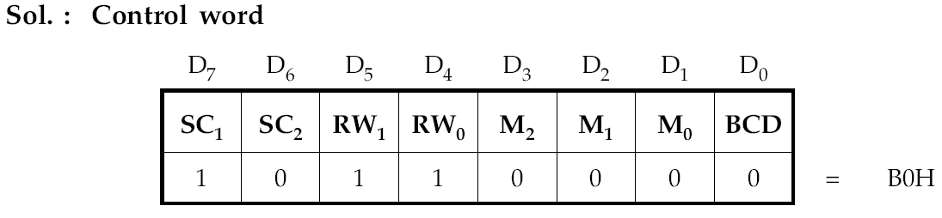
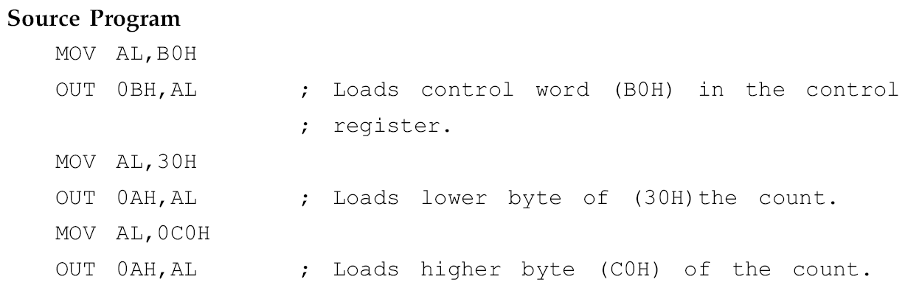
Programming Example

Slide 29
Example & Quiz
The frequency of CLK is 2MHz, write initiation program to let counter 0 generate an interruption request after 100μs, let counter 1 generate 50% duty cycle square wave with a period of 10μs, and let counter 2 generate a negative pulse every 1ms.

Slide 30
MOV DX, 0FF07H
MOV AL, 00010000B ;counter 0, write LSB only, mode 0, binary
OUT DX, AL
MOV AL, 01010110B ;counter 1, write LSB only, mode 3, binary
OUT DX, AL
MOV DX, 0FF04H
MOV AL, 200 ; initial count for counter 0
OUT DX, AL
MOV DX, 0FF05H
MOV AL, 20 ;initial count for counter 1
OUT DX, AL
MOV DX, 0FF07H
MOV AL, 10110100B ;counter 2, write LSB and MSB, mode 2
OUT DX, AL
MOV DX, 0FF06H
MOV AX, 2000 ; initial count for counter 2
OUT DX, AL
MOV AL, AH
OUT DX, AL

Slide 31
Quiz
The frequency of CLK is 2MHz, write initiation program to let counter 1 generate 50% duty cycle square wave with a period of 1s.
Notes:
Use counter 0 to work as a rate generator (mode 2) with an initial count 0 in BCD (the max count), which will generate a clock with the frequency of 200HZ.
Then use OUT0 as the input clock of counter 1, and set the counter 1 to work in mode 3 with the initial count 200.

Slide 32
